Slide 1
Biclustering multiple matrices of time course data
Didi Amar, Daniel Yekutieli, Adi Maron Katz, and Ron Shamir

Slide 2
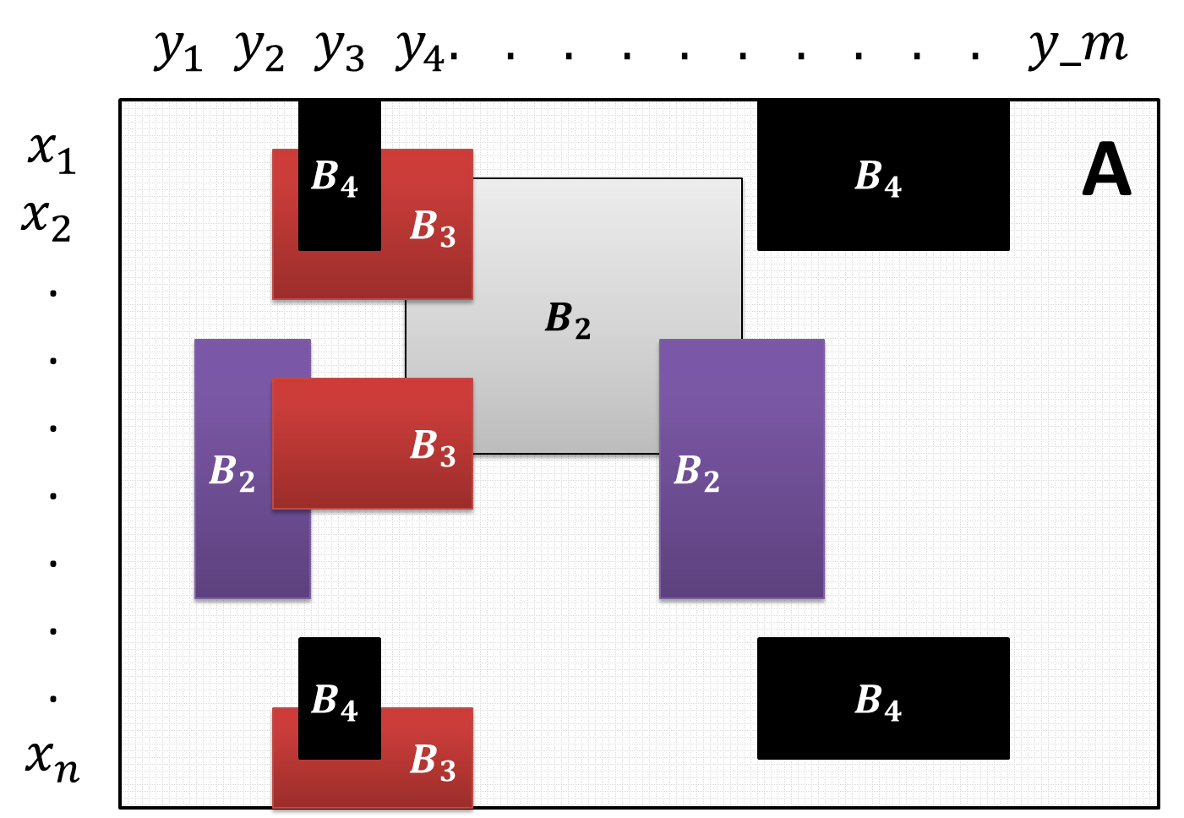
Introduction
Biclustering: simultaneous clustering of rows and columns in a matrix

Slide 3
Introduction
Different bicluster patterns
Coherent values vs. coherent evolutions (Madeira and Olivera 2004)
Examples
Submatrices with “extreme values”
ISA, SAMBA, Debi, LAS, Plaid
Submatrices with similar patterns
OPSM, Cheng-Church, Xmotifs, cMonkey
Time series analysis
EDISA
Combinatorial approaches
SAMBA, Bimax, Debi, FBM

Slide 4
Why use biclustering?
Clustering is a global approach
(Subclasses) A cellular process is active only in a subset of the conditions.
(Biomarker) Only a small set of the genes participates
(Fuzzy) A single gene may participate in multiple processes
Problems: interpretation, overlaps, time

Slide 5
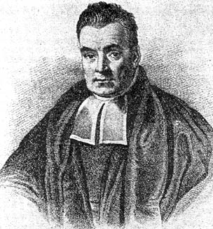
Bayesian statistics
Fundamental change in philosophy
Parameters as random variables
Allows using prior information
likelihood
Bayes Theorem:
Pr(θ|D) = Pr(D|θ) . Pr(θ)
Pr(D)
posterior
prior
Model parameters
The data

Slide 6
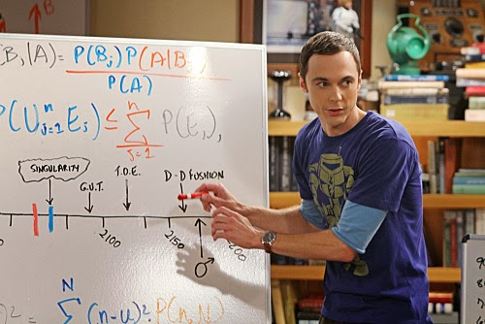
Why Bayesian statistics?
Allows using prior information
E.g., regularization – controlling model complexity
Can be more intuitive
95% “confidence” interval [1.34 < θ < 2.97] means what we “want” it to mean: P(1.34 < θ < 2.97) = 95%
P-values mean what we want them to mean: P(Null hypothesis is false)
MAP can produce a better bias-variance tradeoff than MLE (UMVUE)
Even when the prior is non-informative

Slide 7
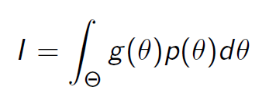
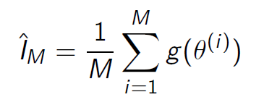
Markov Chain Monte Carlo
Markov Chain: future states are independent of past states given the present state
Monte Carlo: simulation
MCMC: a fancy way of saying we can take quantities of interest of a distribution from simulated draws from the distribution.
VS.

Slide 8
MCMC algorithms
Sometimes we do not have a formula for the distribution
We cannot directly draw from it
Usually the search space is also very large
However, we have some information like:
We can compare the prob. of two points in the space
We have local information for a point x
Under some properties we are guaranteed to sample the entire space when n -> ∞

Slide 9
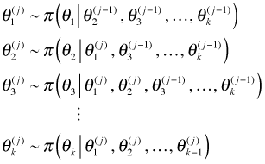
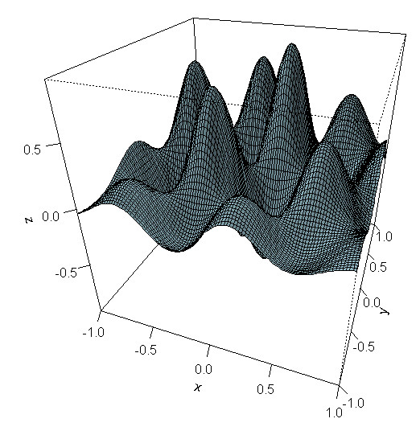
Gibbs sampling
Gibbs: update using conditionals
For optimization: similar to EM, we improve until we converge to local optima

Slide 10
Goal
Old datasets: one matrix of genes vs. conditions
New datasets: a matrix for each sample over time
fMRI
Different tissues
Single cell expression
Use extant algorithms

Slide 11
Notation
Z _{v,t,s}: the data
V voxels/genes
T time points per sample (the sample’s conditions)
S samples
Shared-bicluster vs. sample-specific biclusters

Slide 12
Shared-bicluster and sample-specific
Sample 1
Sample 2
t₁, t₂, t₃, . . . , t_{T}
t₁, t₂, t₃, . . . , t_{T}
B
v₁, v₂, v₃, . . . , v_{V}
A
C

Slide 13
Shared-bicluster and sample-specific
Sample 1
Sample 2
Sample 3
t₁, t₂, t₃, . . . , t_{T}
t₁, t₂, t₃, . . . , t_{T}
t₁, t₂, t₃, . . . , t_{T}
B
D
v₁, v₂, v₃, . . . , v_{V}
A
A
C
D

Slide 14
Hierarchical Bayesian model
The generative model
θ
H
P
HS
C
Z
The observed data
D

Slide 15
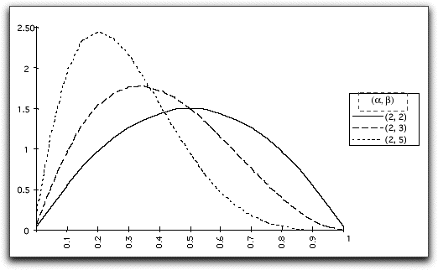
Hierarchical Bayesian model
H_{v} = 1 iff voxel v is in the shared-bic
H_{v} ~ Bernoulli (π^{vc})
H
P
P_{s}: sample-specific probability that a voxel v for which H_{v}=1 is in s
HS
C
Z
π^{vc}, P_{s} have Beta prior distributions
The observed data

Slide 16
Hierarchical Bayesian model
HS: a binary matrix that represents the rows of the sample-specific biclusters
H
P
HS
C
If H_{v}=1: HS_{s,v} ~ Bernoulli(P_{s})
_{Else}
HS_{s,v} ~ Bernoulli(π _{s_c})
Z
The observed data

Slide 17
Hierarchical Bayesian model
C: a binary matrix of time points vs. samples
H
P
Sample s
Window w
HS
C
t
time
Time series analysis
π^{1,1}: P(C_{1,s}=1)
C’_{t,s} = binary: does the time window before t contain 1s?
π ^{1|1} = P(C_{t,s}=1|C’_{t,s}=1)
π ^{1|0} = P(C_{t,s}=1|C’_{t,s}=0)
Z
The observed data

Slide 18
Hierarchical Bayesian model
H
P
If C_{t,s}=1 and HS_{v,s} = 1 then
Z_{v,t,s} is sampled from F₁
Otherwise
Z_{v,t,s} is sampled from F₀
HS
C
Z
The observed data

Slide 19
Gibbs sampler: hyper-parameters
Most hyper-parameters are probabilities
For example, the probability that a voxel v has H_{v}=1 is:
Modeling such parameters in Bayesian statistics is straightforward.
Assume a prior:
Then, the conditional posterior is:

Slide 20
Gibbs sampler: hyper-parameters
Remark: here we usually use non-informative priors.
Example: set a=1, b=1 means that the prior of a probability is uniform [0,1]

Slide 21
Calculating conditional marginals
The basic step when designing a Gibbs sampler
Bayes theorem
Usage example:
A
B

Slide 22
Calculating marginals: H
Steps for calculating the marginal of a variable
Isolate directly related variables, condition on the rest
Calculate different cases and merge

Slide 23
Calculating marginals: H
Steps for calculating the marginal of a variable
Isolate directly related variables, condition on the rest
Calculate different cases and merge

Slide 24
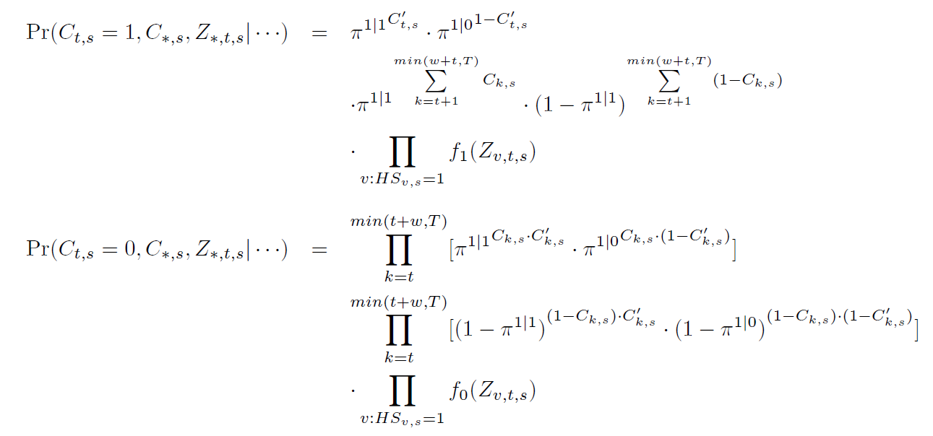
Other calculations
Example of a marginal
Previous and next windows
Go over the relevant rows
When C_{t,s}=0, Z_{vts} ~ F₀

Slide 25
F₀ and F₁
Binary data
F₁ = Bernoulli (π^{LC}) , F₀ = Bernoulli (π^{LCc})
Normal data
Use Gamma-normal model
Other options can be used
E.g., Dirichlet-multinomial for categorical data

Slide 26
Simulations case 1: the simple case
Assume we have one shared-bicluster
No sample-specific signal: P_{s} =1, π _{s_c} =0
V = 500, T = 50, S = 10
Create a binary matrix with 0 values
Sample columns for each subject
π ^{1|1} = 0.6, π ^{1|0} = 0.1
Add a perfect bicluster of 20 rows with 1 values
Add noise:
Binary: flip cell value some probability p
Normal: add Gaussian noise
Use non-informative priors

Slide 27
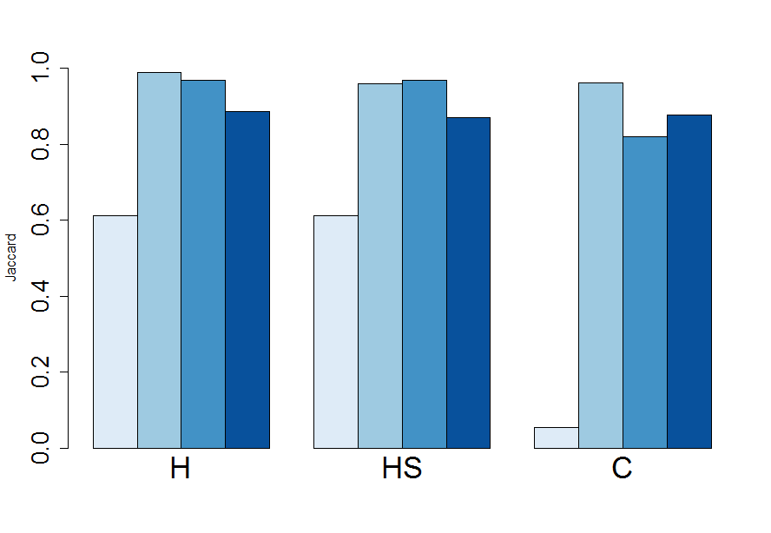
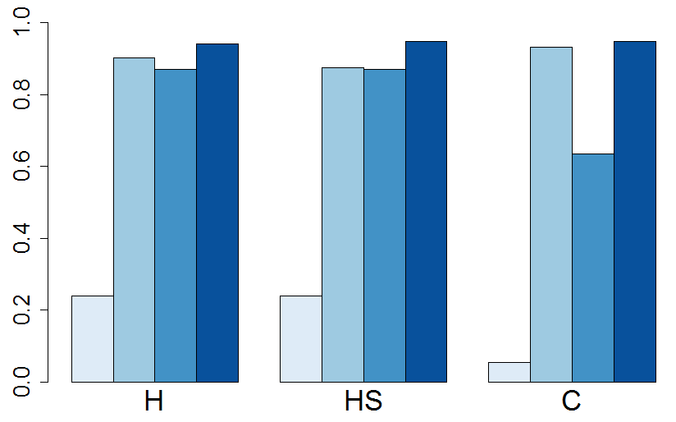
O = noise outside
W = noise within
A) Binary, p_{o}= 0.25, p_{w} = 0.25
50 Gibbs iterations
Running time is ~7 seconds
Jaccard
B) Normal, σ_{o}= 1, σ _{w} = 1
Bimax on normal data: set a threshold of 1
Jaccard

Slide 28
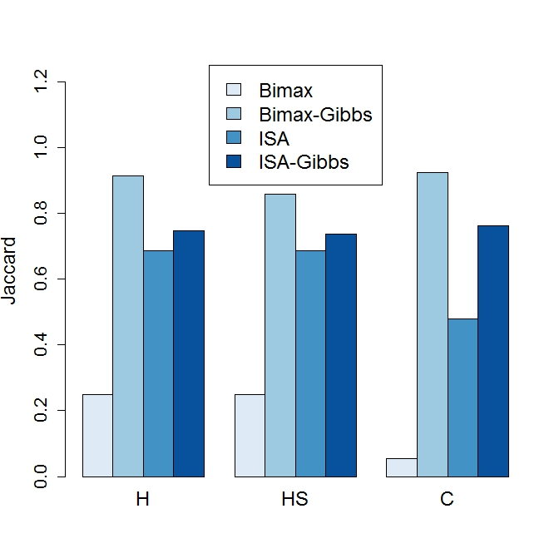
Non-symmetric noise
Binary, p_{o}= 0.1, p_{w} = 0.5

Slide 29
Simulation comments
The Gibbs sampler correctly estimates the parameters
Examples:
π ^{1|1} = 0.6, π ^{1|0} = 0.1
Estimated: 0.58, 0.11
π ^{LC} = 0.75, π ^{LC_c} = 0.25
Estimated: 0.75, 0.255

Slide 30
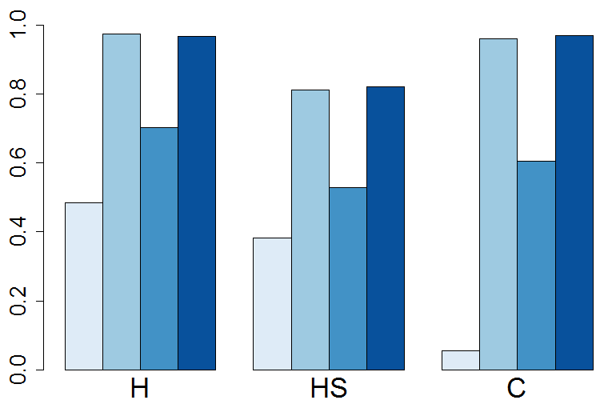
Simulations case 2
Add subject-specific signal
P_{s} = 0.9, π _{s_c} = 0.01
The prob that a row of the shared bic appears in s
The prob that other rows are added to s
Binary, p_{o}= 0.25, p_{w} = 0.25
Jaccard

Slide 31
Wrapper for multiple bics 1
Set hyper-parameters
While TRUE
Take the largest bic after running algorithm A
Run Gibbs
Take the mode over the runs as the solution
Asses the results, the bicluster is good if:
It is large enough (> 10 rows; >10 columns)
π ^{LC} is at least α (0.5)
If the bicluster is bad, terminate
Update Z to its residual
Remove the bic’s signal

Slide 32
Wrapper for multiple bics 2
Set hyper-parameters
Get biclustering solution from algorithm A
Reduce overlaps (Debi)
Foreach bicluster
Improve the solution using the Gibbs sampler
Take the mode over the runs as the solution
Accept the new bic if:
It is large enough (> 10 rows; >10 columns)
π ^{LC} is at least α (0.5)

Slide 33
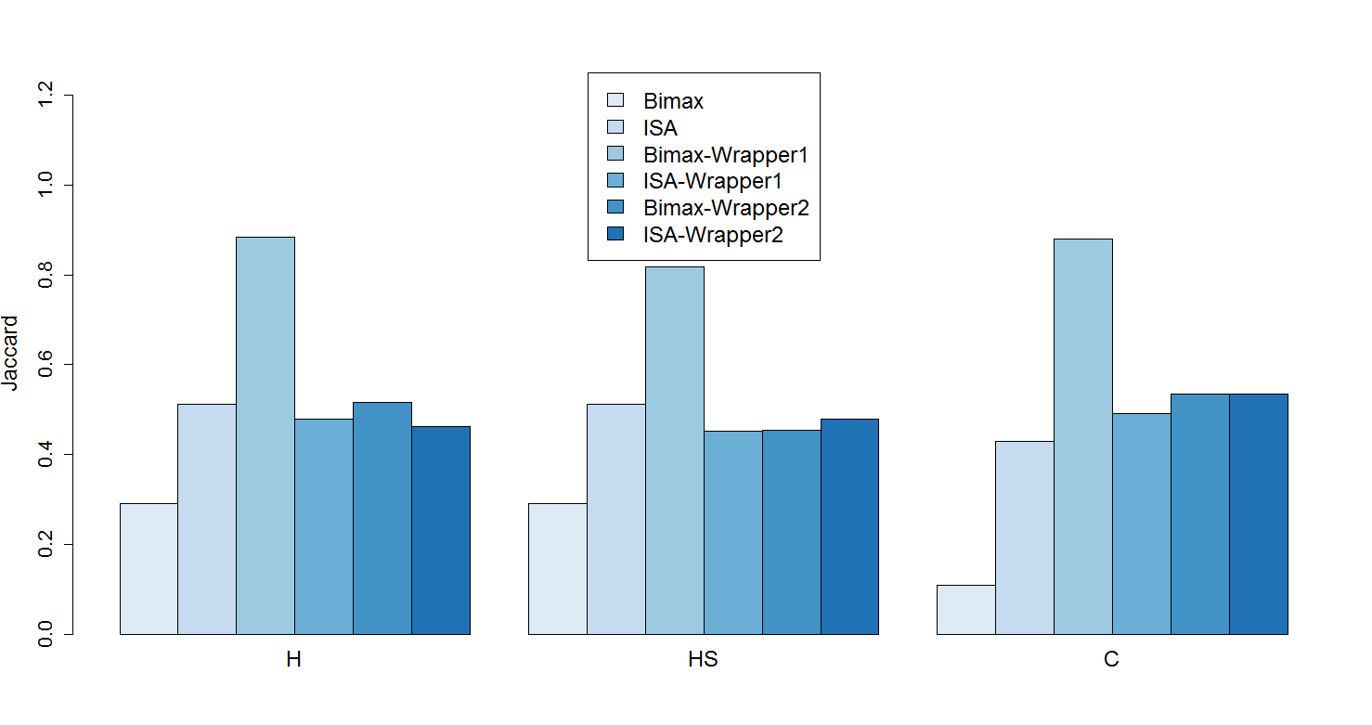
Wrapper comparison: data with 5 bics
Binary data, p=0.25 (within and between)
No sample-specific signal

Slide 34
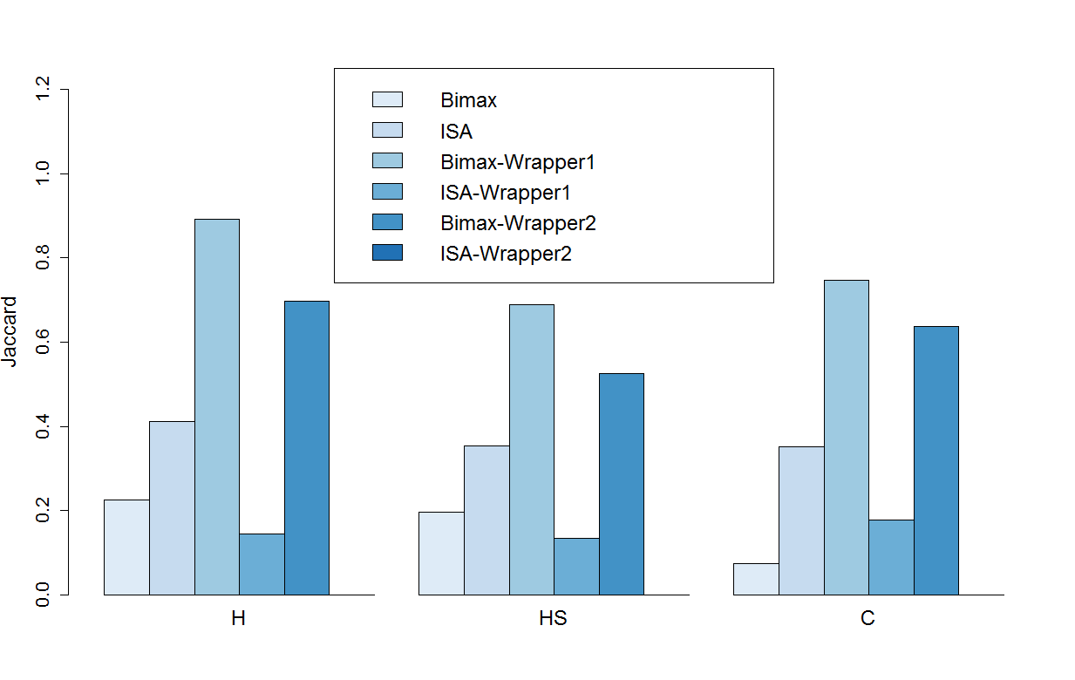
Wrapper comparison: data with 5 bics
Binary data, p=0.25 (within and between)
With sample-specific signal

Slide 35
Summary so far
The Gibbs sampler
Analyzes multiple samples/subjects simultaneously
Uses time course information
Learns parameters
Can be used by heuristics to find multiple bics
Simulations
The performance of classic algorithms is “ruined” when the data contains sample-specific signal or non symmetric noise
Our framework has high performance in all tested cases
Next steps:
Real data applications (vignettes)
More algorithms (biclustering, wrappers)

Slide 36
Real data: fMRI
Rest data
464 parcels, 94 time points, 20 subjects
Rows in each subject were standardized
We look for exceptionally active areas
5-7 Shared Biclusters are detected
Cover 18-20 samples, >100 time points, 25-40 parcels
10-20 sample-specific added rows
P_{s} is ~60%

Slide 37
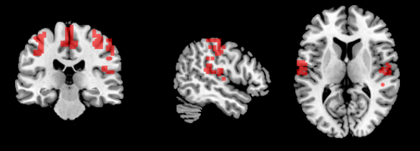
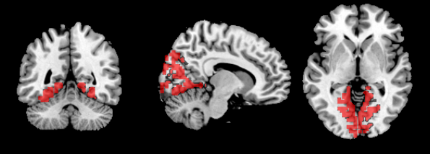
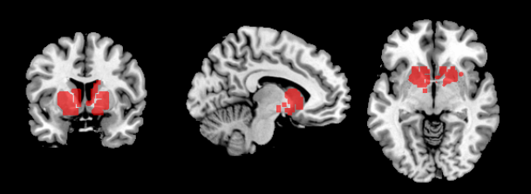
Real data: fMRI
Shared biclusters tend to cover bilateral areas
Shared bicluster 1

Slide 38
Gene expression: Gasch data
Part of the original 2001 Gasch yeast data
Yeast cells under different stresses
Data is relative: we used a 2-fold change threshold and the bimax-binary model
6152 genes, 5 stresses over 7 time points
Up-regulated analysis: one bicluster found
330 genes
18 enriched GO terms related to stress

Slide 39
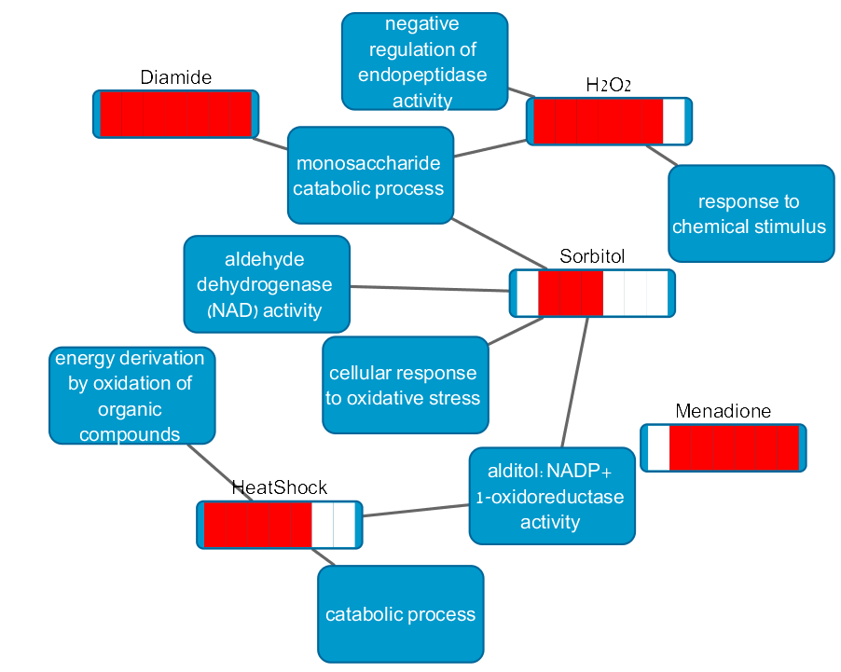
Gasch data
Stress-specific enrichments
Comparison with other algorithms
 | # Bics | % Enrch | Num Terms | ENR
Bimax-Gibbs | 6 | 100 | 27 | 2.6
SAMBA | 38 | 76 | 62 | 3.4
ISA | 50 | 70 | 44 | 4.47
%Enrch: % of bics with some GO enrichment
Num terms: total number of detected GO terms
ENR: enrichment redundancy - average number of times a GO term was reported

Slide 40
Real data: gene expression
Dataset GSE54514: Parnell et al. 2013
Blood samples of subjects after septic shock
14 subjects with 5 time points each
11 subjects that had less time points were removed
For each sample we calculate the log fold change compared to the first time window
In order to find differential genes across time
Binary model threshold: 1 (2 fold change)

Slide 41
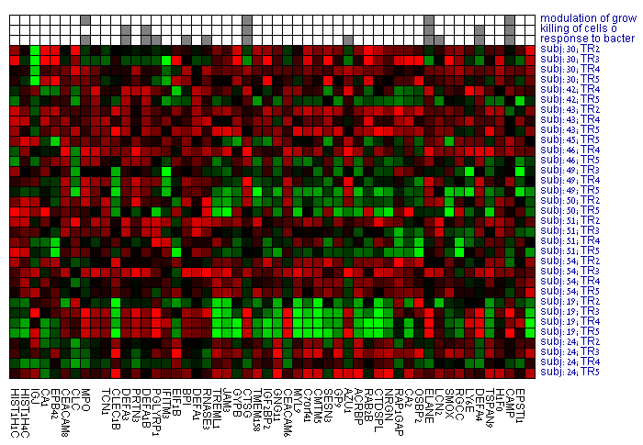
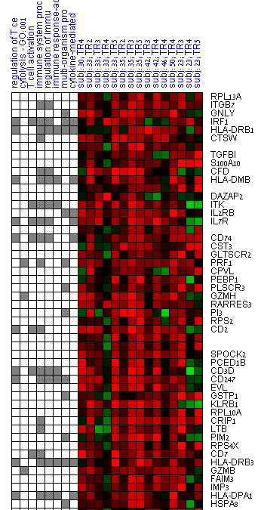
Two shared biclusters
GO
Log fold change
 | # Bics | % Enrch | Num Terms | ENR
Bimax-Gibbs | 20 | 95 | 55 | 2.74
SAMBA | 64 | 37.5 | 45 | 2.55
ISA | 259 | 16 | 38 | 3

Slide 42
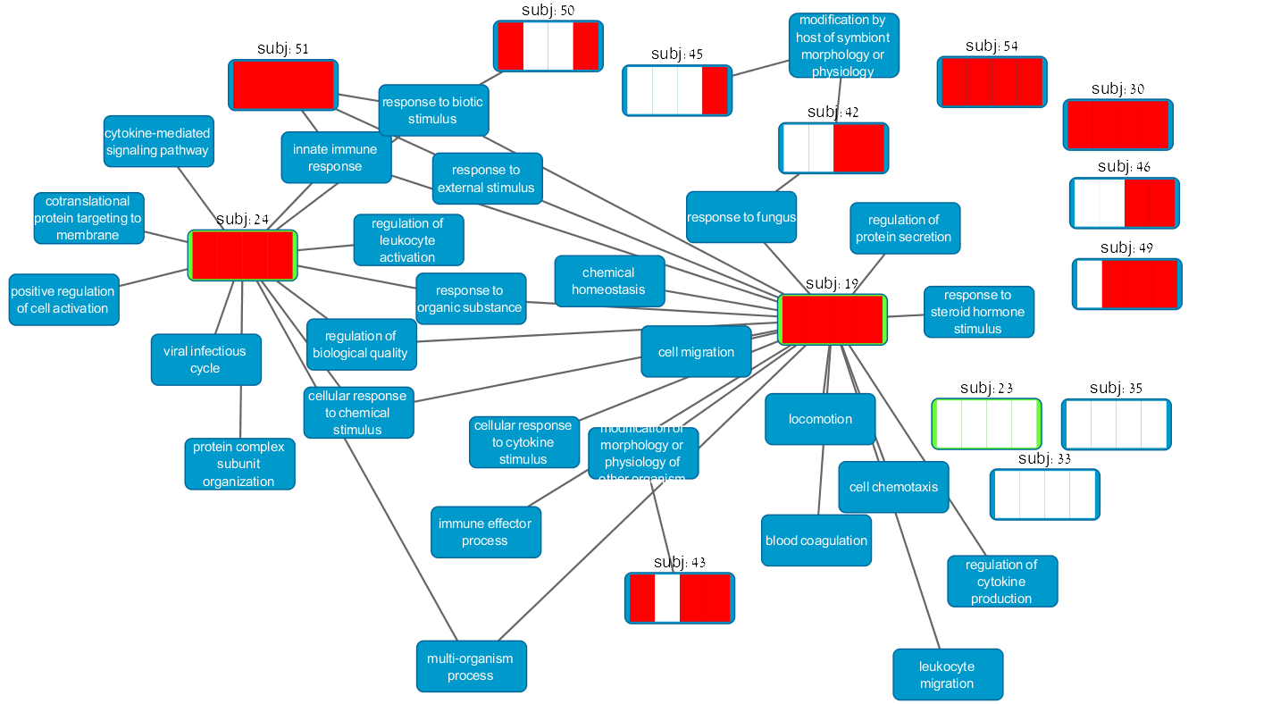
Patient-specific enrichments: bic1
Marked patients did not survive

